Slide 1
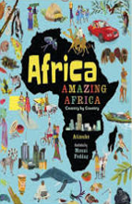
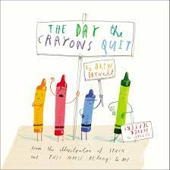

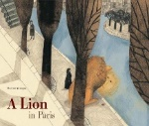
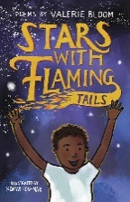
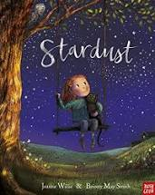
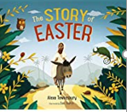
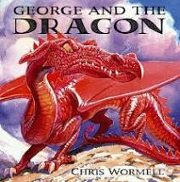
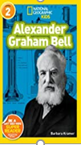
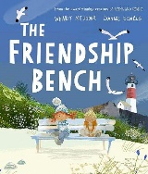
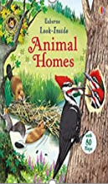
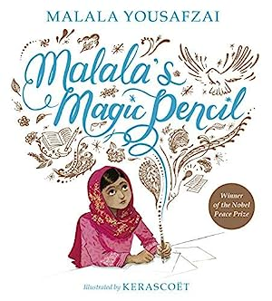
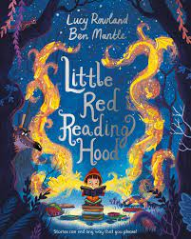
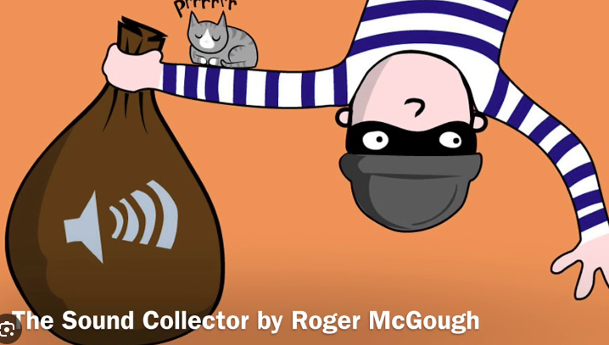

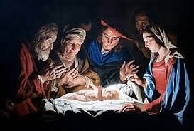
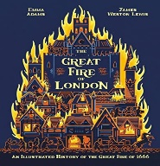

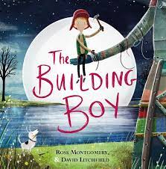
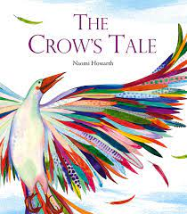

Non-Fiction: Non-Chronological report using a hook question, complex sentence ‘when’, sub-heading, repetition, conjunction ‘but’, time adverbials, precise verbs, precise facts, short sentences.
Non-Fiction: A brochure using Rhetorical question (hook) to begin, direct address, simile, adjectives
setting description, alliteration, persuasive language
Writing Progression – Year Two
Non-Fiction: A letter persuasive letter using alliteration, suffixes, adverb, conjunction ‘when’, precise verbs, conjunctions ‘because’, ‘also’, ‘so’, ‘but’, adverbials, prefix ‘dis’, modal verbs, noun phrase, rhetorical question, positive adjectives.
KAP Point 5
KAP Point 6
Fiction: Classic fiction using, time adverbial, onomatopoeia, prefix, -un, simile, comparatives, superlatives, alliteration, inner thought sentences, sound sentence with action, suffix –ful, contracted form, compound words, dialogue, personification, short sentence for impact,
Fiction: An adventure story using, adjectives, commas in lists, conjunction in a sentence, feelings in a sentence, adverbs, repetition for effect, pathetic fallacy, synonyms, superlatives, fronted adverbial, action sentence, feelings sentence
Poetry: Free verse based on Strange by V. Bloom, using expanded noun phrases, alliteration, onomatopoeia, simile, precise adjectives, precise verbs, metaphor.
KAP Point 4
summer
term
Fiction: a recount of the Easter Story using powerful adjectives in the final position for dramatic effect, rhetorical question, ‘because’ sentence, time adverbials, adverbs, comparative simile, including an adjective
Fiction: a narrative using alliteration, hyphenated words, commas in a list, exclamation, possessive apostrophe, show not tell sentence, comparatives, superlatives, rhyme, dialogue, onomatopoeia, expanded noun phrases.
Non-Fiction: Non-Chronological report using a hook question, complex sentence ‘when’, sub-heading, repetition, conjunction ‘but’, time adverbials, precise verbs, precise facts, short sentences.
Fiction: An adaptation of a legend using repetition for effect, expanded noun phrase, compound words, synonyms , subordination ‘than/when/that, dialogue, adverbs, prepositions.
KAP Point 3
Non-Fiction: A biography using, alliterative title, precise verbs, possessive apostrophe, subordination using ‘when’, list sentence, verbs, positive and negative sentences, noun phrase, dialogue, action, fronted adverbial and exclamation.
Fiction: A narrative based on The Friendship Bench using, metaphor, commas in a list, dialogue, personification, simile, repetition, pathetic fallacy, questions for the reader, complex sentence ‘ly’ opener & verb, onomatopoeia.
Non-Fiction: A description of a habitat using an introduction ‘hook’ question, precise facts, precise nouns, repetition, titles, and sub-headings
Poetry: Humorous poem based on The Sound Collector by R. McGough, using, onomatopoeia, rhythm, rhyme, adjectives, suffix, alliteration, personification, adverbs, repetition, -ing verbs, preposition.
Fiction: An adaptation of a traditional tale with a twist using metaphor, commas in a list, dialogue, personification, simile, repetition, pathetic fallacy, questions for the reader, complex sentence ‘ly’ opener & verb, onomatopoeia.
spring term
KAP Point 2
Non-Fiction: Non-chronological report using rhetorical question, statements, ‘because’ sentence, labels, captions, adjectives in the final position, subordination ‘when’.
Non-Fiction: A diary entry based on the events witnessed by Samuel Pepys using time adverbials, superlatives, repetition, alliteration, precise verbs, simile, question, adverbs and verbs, adjectives.
KAP Point 1
Fiction: a recount of the nativity story using alliteration, rhetorical question, time adverbials, onomatopoeia, adverbs, comparative similes including an adjective.
autumn term
Fiction: Free verse based on the poem’ If I Were in Charge of the World’ using contraction, expanded noun phrase repetition, inverted commas.
Fiction: An adaptation of an adventure story using possessive apostrophe, contracted form, commands, past and present tenses, comparatives & superlatives
Fiction: An adaptation of a traditional tale using repetition, adverbial phrases, ?, !, questions repeated for effect, simile, time adverbials, subordinating conjunctions, commas in lists, onomatopoeia, expanded noun phrases, speech.

