Slide 1

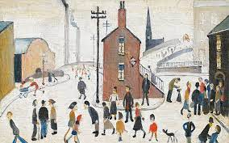
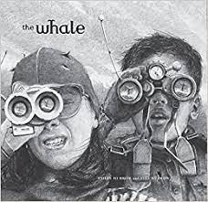
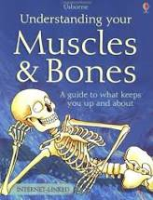
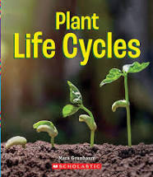
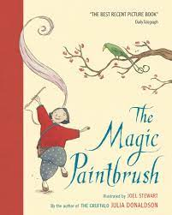
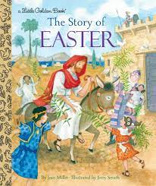
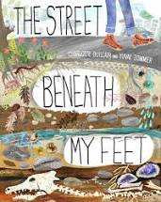
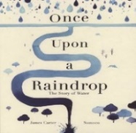
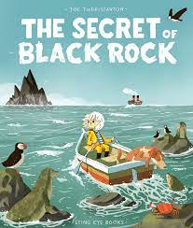
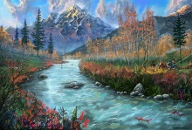
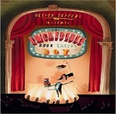
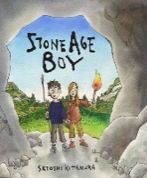


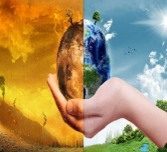
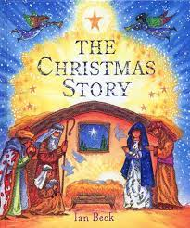
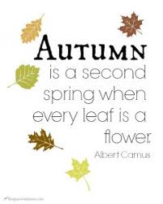
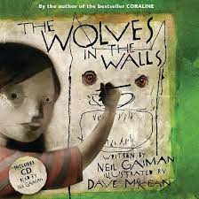
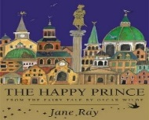

KAP Point 5
Writing Progression – Year Three
Fiction: An adaptation of an adventure story using rhetorical questions, relative clause, complex sentence, fronted adverbials (double stack), pathetic fallacy, simile, metaphor, superlatives, adjectives, dash, news flash, headline (pun), strapline (alliteration).
Non-Fiction: Non-Chronological report using, adjectives, verbs, time adverbs, rhetorical question, noun phrases, technical vocab, ‘when’ complex sentence, humour.
Poetry: Free verse using personification, repetition, noun phrase, expanded noun phrase, precise verbs, commas for effect, simile.
KAP Point 6
Non-Fiction: Chronological report using simile, adjectives, verbs, time adverbials, rhetorical question, noun phrases, sub-headings, technical vocabulary, humour, conditional ‘if’
Non-Fiction: An explanation using repetition for effect, hyperbole, alliteration, adjectives & technical language, time adverbial, precise verb, question, ‘because’ sentence, disclaimer conjunction ‘if’.
summer
term
Fiction: An adaptation of a traditional tale using imperative verbs, repetition simile x3, short sentences, time adverbials, alliteration, adverb x 3, precise verbs x 3, complex sentence.
KAP Point 4
Non-Fiction: Script for Factual Tour: To understand the structure and language features of a guided factual tour.
Fiction: a recount of the Easter Story using powerful adjectives in the final position for dramatic effect, rhetorical question, ‘because’ sentence, time adverbials, adverbs, comparative simile, including an adjective
Non-Fiction: An explanation using questions, prepositional phrases, alliteration, ‘which’ clause using 2 commas, repetition for effect, action verbs, joke/pun, captions, onomatopoeia, synonyms,
KAP Point 3
Poetry: Free verse using metaphor, rhyme, personification, rhythm, adjectives, half rhyme.
Fiction: An adaptation of a mystery using, time adverbials, repetition, conjunction ‘until’, inverted commas, adverb ‘how’, precise verbs, present perfect form, determiners ‘a/an’ synonyms, dialogue.
Fiction: A comic tale using conjunctions, alliteration, colon, simile, prefix, comparatives and superlatives, question, dialogue, preposition, adverb, inner thoughts, past perfect verbs, fairy tale phrases.
Fiction: Based on Stone Age Boy using, adjectives, precise verbs, repetition and feeling, complex sentence, preposition, repetition, adverbial descriptive noun phrase, direct speech.
KAP Point 2
spring term
Fiction: a recount of the nativity story using alliteration, rhetorical question, time adverbials, onomatopoeia, adverbs, comparative similes including an adjective.
KAP Point 1
Non-Fiction: An explanation using, heading (question), repetition for effect, hyperbole, alliteration, cause & effect language, adverb, conjunction ‘if’, ‘when’.
Non-Fiction: A magazine article using heading (question), repetition for effect, hyperbole, alliteration, cause & effect language, adverb, conjunction ‘if’, ‘when’.
Non-Fiction: A review using a statement, precise adjectives/adverbs, conjunction, complex sentence, expanded noun phrase, hyperbole, question, ‘because’ sentence.
autumn term
Poetry: Poetry: Free verse using expanded noun phrases, precise verbs, rhyme, simile, metaphor, repetition.
Fiction: an adaption of a mystery story using, rhyme, alliteration, verbs (power of 3), rhetorical questions, subjunctive form, pathetic fallacy , short sentences, metaphor, show not tell sentence, dialogue, prepositions
Fiction: An adaptation of a traditional tale using complex , synonyms, precise verb, question, contracted form, possessive apostrophe, onomatopoeia, expanded noun phrase, suffix ‘less’, prepositions, powerful adjectives.

