Slide 1
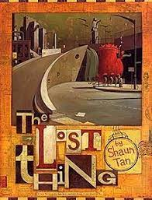
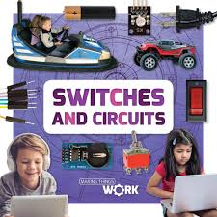
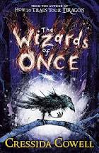

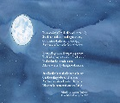
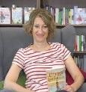

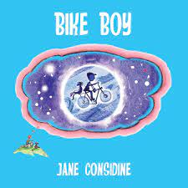

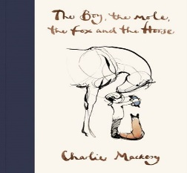
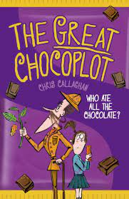
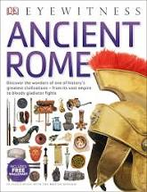
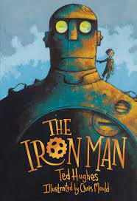
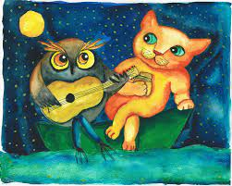
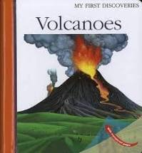
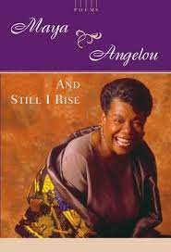
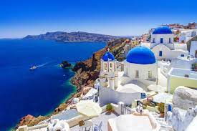
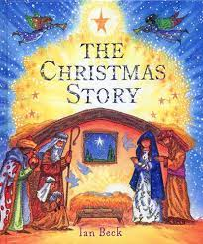

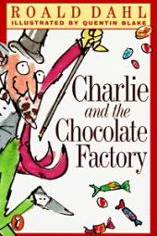
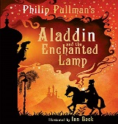

Fiction: An adaptation of a fantasy using time adverbials, synonyms, adjectives, technical words, portmanteau words, dialogue, adverbs, kennings, complex sentences, onomatopoeia,
Writing Progression – Year Four
An explanation using, heading (question), repetition for effect, alliteration, adjectives and technical language, time adverbial and precise verb, adverb and imperative verb, question and ‘because’ sentence disclaimer, conjunction ‘if’, ‘when’.
Non-Fiction: Postcard using a greeting, chatty style, humour/pun, rhetorical question, punctuation, dash, ellipsis, exclamation mark.
KAP Point 6
KAP Point 5
Non-Fiction: A newspaper report using headline (pun), strapline (alliteration), 5W questions, precise verbs, since clause, simile, expanded noun phrase, action & hyperbole, quote, subordinate ‘if’, reported speech.
Non-Fiction: An explanation using, heading (question), repetition for effect, alliteration, adjectives and technical language, time adverbial and precise verb, adverb and imperative verb, question and ‘because’ sentence disclaimer, conjunction ‘if’, ‘when’.
Poetry: Rhyming verse an adaptation of ‘The Moon’ by R.L Stevenson using personification, rhyme, alliteration, simile, metaphor, precise adjectives, verbs and adjectives.
Non-Fiction: a persuasive letter using, contrasting conjunctions, adjectives, verbs, power of 3, alliteration, adverbs, persuasive language, simile, quotes, plea – power of 3,, snappy slogan.
Fiction: An adaptation of an adventure using, time adverbial, simile, personification, kenning, complex sentence, ‘if only’, contracted form, dialogue, personification, adverbial phrase ‘how’, repetition for effect, pathetic fallacy, power of 3.
Fiction: A playscript using characterisation (scene-setting), feeling (stage-direction), simile (exaggeration), expanded noun phrase, repetition, scene setting (summarising), dialogue (showing feelings), adverb (stage direction).
Fiction: A playscript using characterisation (scene-setting), feeling (stage-direction), simile (exaggeration), expanded noun phrase, repetition, scene setting (summarising), dialogue (showing feelings), adverb (stage direction).
summer
term
Fiction: An innovation using, expanded noun phrase, simile, repetition for effect, metaphor, onomatopoeia, relative clause, fronted adverbials, complex sentence, alliteration, speech/dialogue, Contrasting conjunctions – ‘She was struck by how dark and dingy the caravan was, compared to the bright, vibrant rainforest’
KAP Point 4
Non-Fiction: A newspaper report using headline (pun), strapline (alliteration), 5W questions, precise verbs, since clause, simile, expanded noun phrase, action & hyperbole, quote, subordinate ‘if’, reported speech.
Non-Fiction: An information leaflet using, alliteration, adjectives and verbs, evocative language, question, chatty reply, simile, metaphor, precise verbs, adjectives and nouns, verb starter, alliterative slogan, relative clause, imperatives, call to action/testimonial.
KAP Point 3
spring term
Fiction: An adaptation of a Sci-Fi using, short sentences, noun phrase, simile, questions, noun phrase, extended metaphor, onomatopoeia, repetition, short v long sentences, brackets, personification, dialogue, complex sentence & alliteration, relative clause, adverbial phrases, prepositions.
Poetry: Victorian nonsense verse using, precise adjectives, rhythm, alliteration, personification, metaphor, imagery, repetition for effect.
Non-Fiction: A newspaper report using headline (pun), strapline (alliteration), 5W questions, precise verbs, since clause, simile, expanded noun phrase, action & hyperbole, quote, subordinate ‘if’, reported speech.
KAP Point 2
KAP Point 1
Fiction: A persuasive letter using persuasive language, hyperbole, fronted adverbial, rhetorical question, precise verbs and adjectives, precise nouns.
Poetry: Shape poem using, nouns, rhyme, constant simile (things that do not change – the setting of the sun, constant metaphor, adverbial, precise adjectives and verbs, repetition.
autumn term
Fiction: An adaptation/innovation using repetition for emphasis, adverb, simile, dialogue, conjunction, short sentences, onomatopoeia, ellipsis, adjectives, complex sentence, relative clause, imagery, short sentences, expanded noun phrase.
Non-Fiction: A holiday brochure & postcard using pun, rhyme, prefix –super, rhetorical question (hook), direct address, complex sentence, simile, adjectives, imperatives verbs (power of 3) ‘relax, recline, unwind’, alliteration, hyperbole using superlatives, comfiest, softest…
Fiction: An adaptation of a traditional tale using verbs, adverbs, alliteration, simile, prepositions, question, singular apostrophe/plural apostrophe, personification, repetition for effect, pathetic fallacy, complex sentence.

