Slide 1
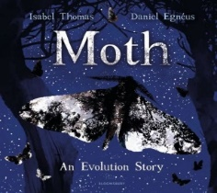
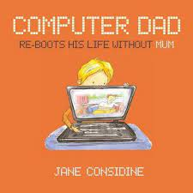
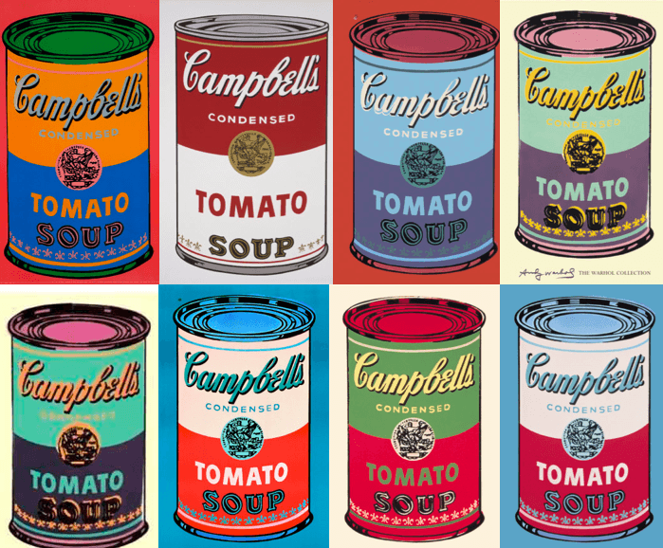
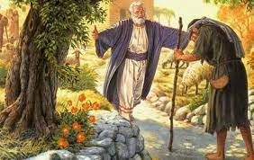
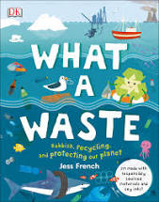
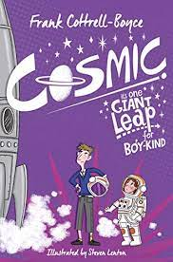
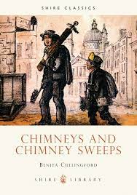
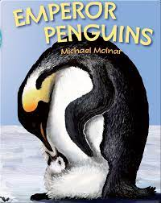
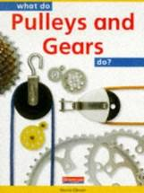
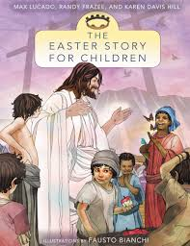
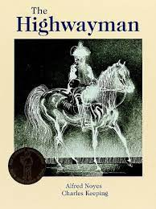
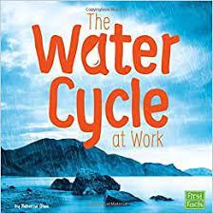
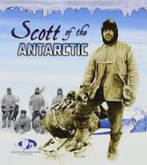
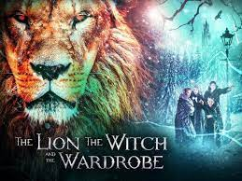
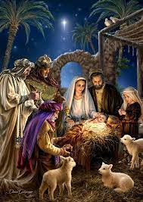
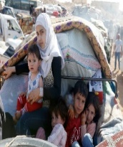

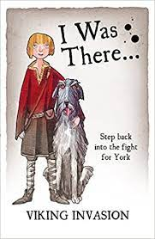
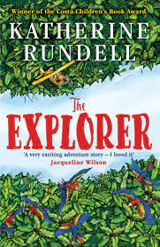
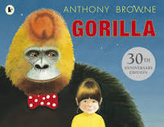

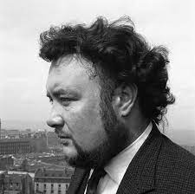
Writing Progression – Year Five
Poetry using personification, rhyme, alliteration, simile, metaphor, imagery, precise adjectives, precise verbs, commas for effect, parenthesis for impact, pathetic fallacy.
Fiction: An adaptation using, repetition and ellipsis, complex sentence (flashback), short sentences, conjunction (contrasting), compound adjectives (hyphenated) relative clause, pathetic fallacy, time adverbial, single verbs for impact, pun, semi-colon, expanded noun phrase, brackets, dash for independent clause.
KAP Point 6
Non-Fiction: A biography of the life of Andy Warhol using subordinating conjunction, verbs x 3 opener, parenthesis, brackets, dashes and commas, simile, expanded noun phrase, relative clause, short sentences, modal verbs, oxymoron and fronted adverbial, precise verbs.
Non-Fiction: a speech using, rhetorical question, adverbials, metaphor, superlative conditional ‘if’, colon, semi-colon, counteract existing viewpoint, acronym, alliteration, compound words x 3, antonyms , ‘but conjunction.
KAP Point 5
Fiction: An adaptation of ‘The Lost Son’, using, rhetorical question, simile, metaphor, imagery, precise adjectives, precise verbs, commas for effect, exclamation for effect, parenthesis for impact.
Fiction: An adaptation of an adventure Sci-Fi using, adverbs –degrees of possibility, powerful adjectives, question, dialogue, short sentences for effect, relative clause sentence, commas in lists, complex sentence, pathetic fallacy, modal verbs.
Non-Fiction: A job advertisement using, headline, rhetorical question, precise nouns, commas for effect, technical vocabulary , hyperbole.
Fiction: A recount of the Easter story using, rhetorical question, adverbial phrase, relative clause, brackets, alliteration, modal verbs and dialogue.
summer term
KAP Point 4
Non-Fiction: Product review using, heading, question, repetition hyperbole, alliteration, adjectives, technical language, cause and effect language, onomatopoeia, ‘because’ sentence.
Fiction: An adaptation of the narrative poem, The Highwayman, using, short sentences, adjectives in a list, metaphor, alliteration, simile, dialogue, precise verbs, personification.
Non-Fiction: A non-chronological report using, alliteration, pun, relative clause, expanded noun phrase, superlatives, rhetorical questions, modal verb, adjectives, complex sentence, technical language, brackets, precise verbs, subordinating conjunction.
Non-Fiction: A biography using, subordinating conjunction, verbs x 3 opener, parenthesis, brackets, dashes and commas, simile, expanded noun phrase, relative clause, short sentences, modal verbs, oxymoron and fronted adverbial, precise verbs.
Non-Fiction: An explanation of The Water Cycle using heading (question), prepositions, hyperbole, alliteration, precise nouns, adjectives, technical vocabulary, cause and effect language, time adverbial and precise verb, adverb and imperative verb.
KAP Point 3
Non-Fiction: A post card using, openings, chatty style, dash, ellipsis, time adverbials, precise language and feelings, short sentences, fronted adverbial, brackets, questions, rhetorical question.
spring term
KAP Point 2
Fiction: An adaptation of a fantasy story The LWW, using, adverbial phrase, dialogue, complex sentence, relative clause, brackets, repetition for effect, simile, alliteration, modal verbs and dialogue, precise adjectives, passive voice, onomatopoeia, metaphor.
Fiction: Writing a Speech – AA journey of a refugee - using, adverbial opener, action verbs, dash, personification, simile, synonym and verb, brackets, adverb/adverbial phrase, parenthesis, repetition, feelings and personification, synonyms, colon, repetition, relative clause ‘who’, ‘which’.
Non-Fiction: A balanced argument using, time adverbial, metaphor, colon, contrasting conjunction, subordinate clause, quotation, adverb, formal language, suffixes, modal verb, brackets, dash, commas in a list, complex sentence, alliteration.
Non-Fiction: Recount of a ‘real’ event using, adverbial opener, action verbs, dash, personification, simile, synonyms and verb, onomatopoeia and precise verb, brackets, adverb, adverbial phrase, short sentences, inner thought.
Poetry: based on Malfeasance by Alan Bold using, adjectives, expanded noun phrases, precise nouns, precise verbs, rhyme, simile, metaphor, repetition for effect, onomatopoeia.
KAP Point 1
autumn term
Fiction: Adventure Story: mimic sentence structure, ‘Rundell sentence’, complex sentence, metaphor, colon, personification, show not tell sentence, dialogue, simile.
Fiction: An adaptation of an adventure story using, relative clause, adverbs, adverbial phrase, modal verbs, simile/metaphor, alliteration, complex sentence, adjectives/synonyms, onomatopoeia, time adverbial, personification, short sentences, question.

