Slide 1
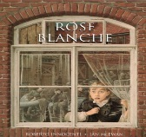
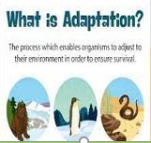

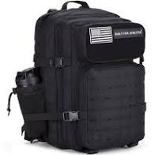
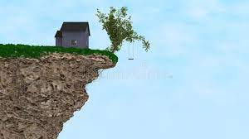
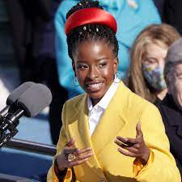

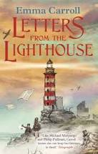
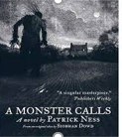
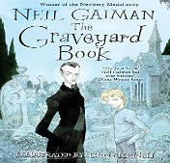
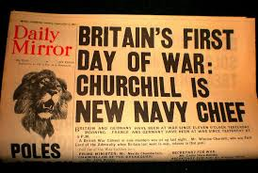
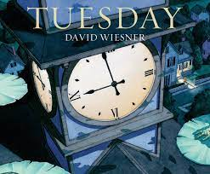
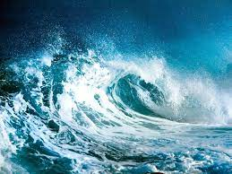

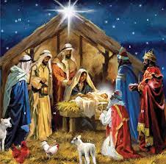

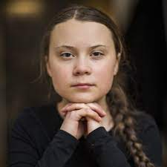
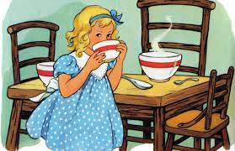
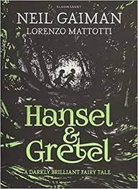
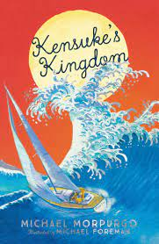
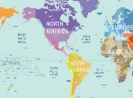

Non-Fiction: product review using, simile, precise adjectives, verbs, rhetorical question, noun phrases, sub-headings, technical vocabulary, ‘when’ complex sentence, conditional ‘if’ sentence, pun, hyperbole.
Non-Fiction: Informal letter using, relative clause, actions, metaphor, inner thought, adverb/simile, dialogue/semi-colon, adverb, complex sentence, brackets, precise verbs, pathetic fallacy, repetition for effect, negative adjective, mirroring of full circle ending, symbolic ending.
Non-Fiction :Information leaflet using, alliteration, technical vocabulary, colons, dashes, brackets, captions, contrasting conjunction, subordinate clause, short sentences, facts, brackets, headings.
Non-Fiction: Speech using, precise verbs, repetition noun phrase, personification, complex sentence, short sentence, facts, relative clause, modal verb, emphasis, hyperbole.
KAP Point 6
Non-Fiction: Balanced report for/against using, time adverbial & powerful adjective, colon to introduce a list, contrasting conjunction, subordinate clause, relative clause, adverb and formal language, data, brackets, rhetorical question, complex sentence, alliteration, metaphor, concluding statement.
Poetry: Speech poem using, repetition for effect, simile, metaphor, imagery, precise adjectives, precise verbs, commas for effect, exclamation for effect, parenthesis for impact, rhetorical question.
KAP Point 5
KAP Point 4
summer term
Fiction: An adaptation of a horror story using list-like phrases, short sentences, fronted adverbials, rhetorical questions, time clues, complex sentences, relative clause, personification, alliteration, adjectives in unusual positions, dialogue, subjunctive form, synonyms., subordinating conjunctions.
Fiction: An adaptation of an adaptation using, superlatives, 5Ws, personification, simile, onomatopoeia, power of 3 (verbs), adverbial, conjunction, subjunctive form, expanded noun phrases, metaphor, pathetic fallacy, time adverbial, repetition, complex sentence, parenthesis.
Non-Fiction: A recount from a character’s perspective using, dialogue, prepositions, simile, character description, short sentences, precise verbs, personification, dialogue adverbial, expanded noun phrases, show not tell feeling sentence.
Fiction: Adaptation of a spooky tale using, dialogue opener, simile, character description/action, precise verbs, personification, dialogue, expanded noun phrases, action show not tell, feeling show not tell, informal direct speech, -ing opener, suspense- long/short sentences.
Fiction: Newspaper report using, headline/pun, strapline/alliteration, caption, 5Ws, fronted adverbials, hyperbole, urgent questions, formality shifts, passive voice, power of 3 in a list, complex sentence, subjunctive form, formality shifts – informal, informal tweets.
Fiction: Adaptation of a sci-fi using, 3 x –ed opener, dialogue opener, prepositions, simile, character description, short sentences, onomatopoeia, precise verbs, personification, dialogue, adverbial, expanded noun phrases, show not tell feeling/noun phrases, ‘when’ adverbial.
Poetry :Rhyming verse based on ‘The Great Water Giant’, using, metaphor, personification, pathetic fallacy, expanded noun phrases, onomatopoeia, precise verbs, precise adjectives, rhyming verse, rhythm imagery.
Fiction: Newspaper report using, headline/pun, strapline/alliteration, caption, 5Ws, fronted adverbials, hyperbole, urgent questions, formality shifts, passive voice, power of 3 in a list, complex sentence, subjunctive form, formality shifts – informal, informal tweets.
KAP Point 3
Non-Fiction: A biography using, alliteration, time adverbial, precise verbs and adjectives, pun, conjunction, fact, subordinate conjunction, dialogue, superlative, cohesion, alliteration, precise verbs, colon, questions, inner thought, rhetorical question.
spring term
Non-Fiction: Newspaper recount using, headline, pun, strapline, alliteration, caption, 5Ws, fronted adverbials, hyperbole, urgent questions, formality shifts (dialogue & ‘tweets’), passive voice, power of 3 in a list, complex sentence, subjunctive form, reported speech, bullet points, dashes, quote.
Non-Fiction: Persuasive Speech using, metaphor, precise verbs, repetition, science facts, noun phrase, relative clause, elaborate facts, personification, repletion, complex sentence, facts, counter viewpoint, direct address, modal verb, colon, adverbs, antonym, passive/active voice, emphasis.
Poetry: An adaptation of a RAP using, verbs, rhyme, repetition, prepositions, adverbial, personification, collective nouns.
KAP Point 1
Non-Fiction: Comparative non-chronological report using, alliteration & pun, relative clause, expanded noun & superlative, rhetorical question, modal verb & adjective, complex sentence & superlative, adverbial & colon, long and short sentences, technical language, relative clause, pun, fronted adverbial, brackets, subordinate conjunction, precise verbs, labels, captions, fact boxes, bullet points.
Autumn Term
6
Fiction: A re-telling of a traditional tale using, inverted commas & conjunctions, repetition for effect, adjectives & similes, modal verbs & semi-colon, adverbial phrase & semi-colon, complex sentence, alliteration & repetition, comparatives & superlatives.
Fiction: An adaptation of an adventure story using, prepositions, adjectives. Collective nouns, complex sentence, repetition for effect, relative clause, modal verbs, rhetorical questions, sounds & symbolism, onomatopoeia, personification, pathetic fallacy, dialogue, passive voice, semi-colon to divide clauses, metaphor.

